Slide 1
Welcome to my Presentation
Rudro Mondal
ID NO: 11

Slide 2
Employee Performance
Employee performance refers to how well an individual fulfills their job responsibilities and contributes to achieving organizational goals. It encompasses the quality, efficiency, and effectiveness of the work performed, as well as factors like attitude, teamwork, and adaptability. High employee performance drives organizational success, boosts productivity, and fosters a positive workplace culture.

Slide 3
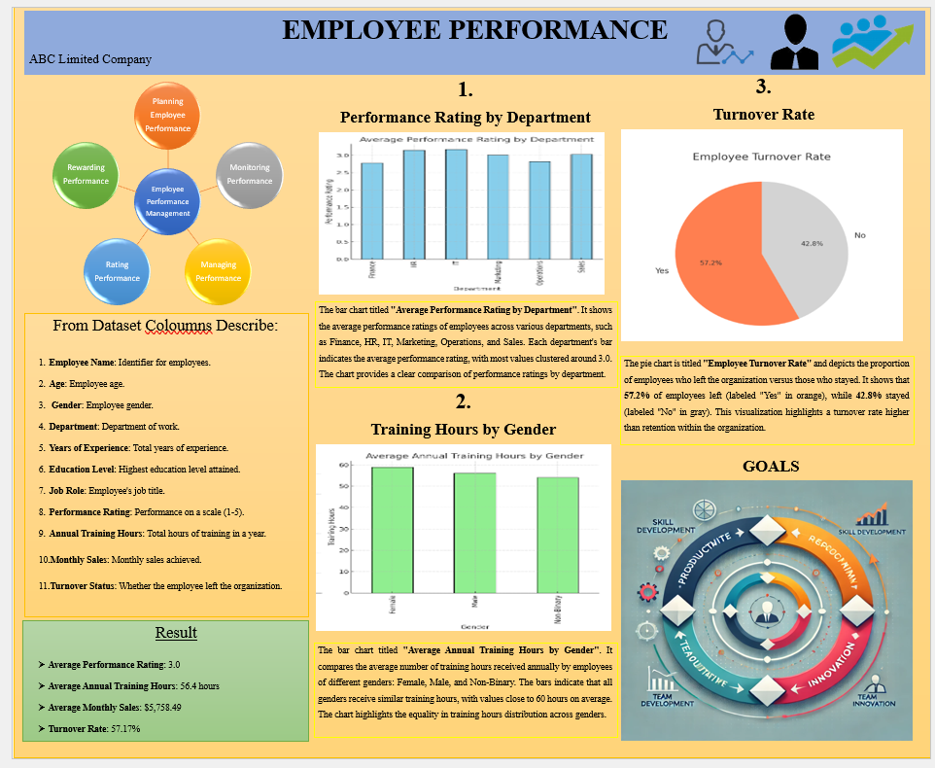
Poster

Slide 4
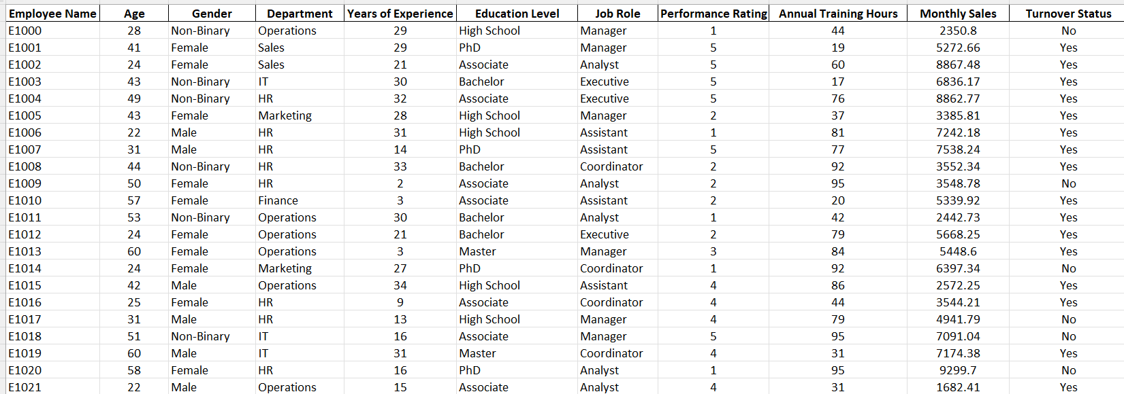
Dataset

Slide 5
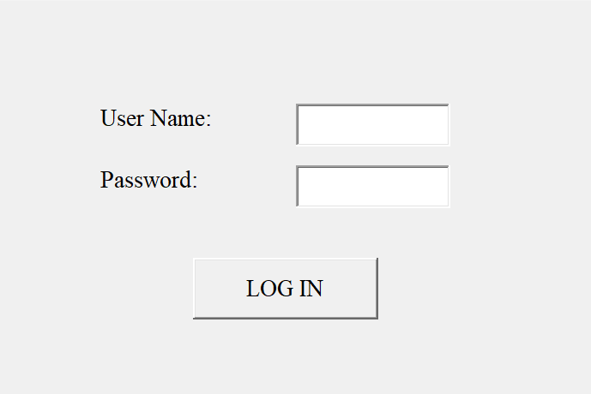
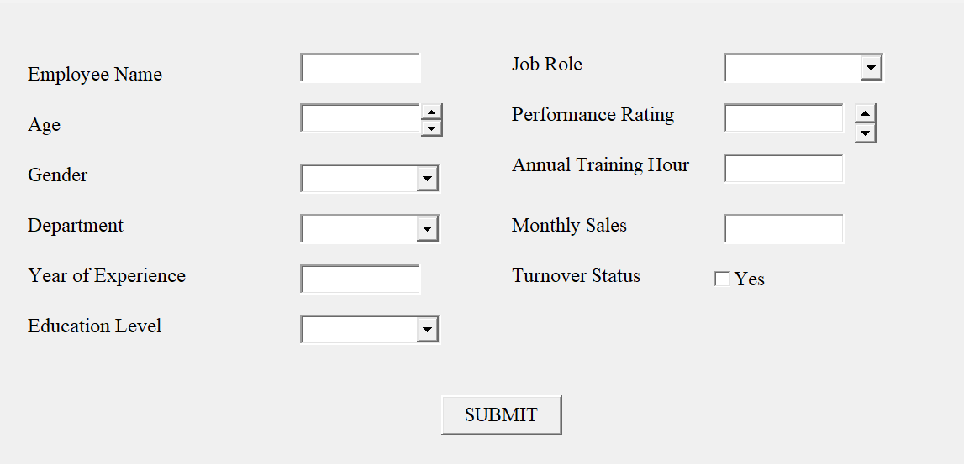
Input form
Log in form

Slide 6

Details: Employee name: Identifier for employees. Age: Employee age. Gender: Employee gender. Department: Department of work. Years of experience: Total years of experience. Education level: Highest education level attained. Job role: Employee's job title. Performance rating: Performance on a scale . Annual training hours: Total hours of training in a year. Monthly sales: Monthly sales achieved. Turnover status: Whether the employee left the organization.

Slide 7
Total result
Average Performance Rating: 3.0
Average Annual Training Hours: 56.4 hours
Average Monthly Sales: $5,758.49
Turnover Rate: 57.17%

Slide 8
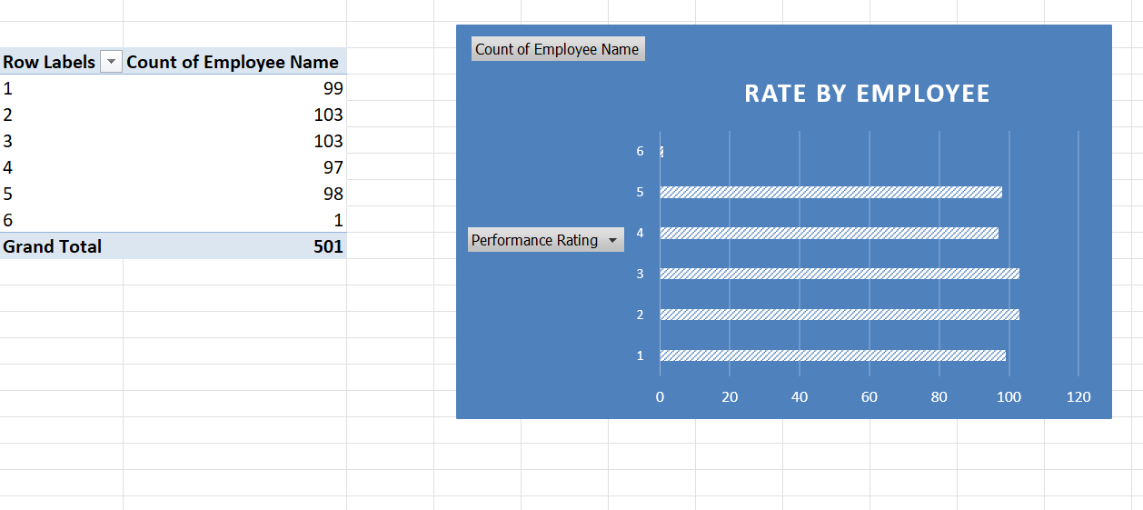
What is the distribution of employees across performance ratings show it graphically by bar chart?
Question No 04
The bar chart shows that the count number depend on the performance rating. When the performance rate was 2 and 3 the employee was highest and it 103 persons. The highest rate was 6 but the employee only 1 person.

Slide 9
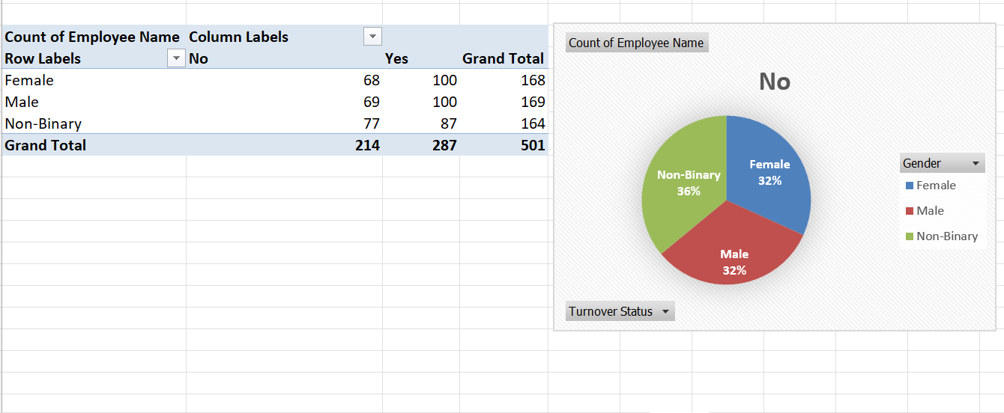
How many employees are in each gender group by turnover status and make a pie chart for turnover status "NO"?
Question No 06
Here the Pie chart show us that only for the turnover status “NO”. Then the Female employee was 32% it means only 68. Male employee was also 32% but the employee was 69. At last, the pie chart describes that the non-binary employee was 36% and the employee was 77 it was the highest rate for turnover status “NO”.

Slide 10
Employee
Performance
Management
Planning
Employee
Performance
Monitoring
Performance
Managing
Performance
Rating
Performance
Rewarding
Performance

Slide 11
GOALS
Goals for employee performance are objectives set to align individual efforts with organizational priorities, driving productivity and success. These goals typically include improving job-specific skills, enhancing efficiency, meeting or exceeding key performance indicators (KPIs), and contributing to team and organizational objectives. Setting clear, measurable, and achievable goals fosters motivation, provides a sense of direction, and ensures accountability. Additionally, goals may focus on personal development, innovation, and fostering collaboration, helping employees grow while adding value to the organization.

Slide 12
Thank you
Utpal Adhikari
Department of Management Studies
Batch 03 of CF & OA
Email: utpaladhikari70@gmail.com

